Slide 1
MUSIC STORE DATA ANALYSIS
PRESENTED BY :
S.VINAY KUMAR

Slide 2
OBJECTIVE
This analysis aims to increase the business growth of the music store by addressing some existing challenges.
We want to help the music store grow by looking at it’s data.
By using SQL and answering some questions, we can figure out how to tackle the challenge and boost the business.

Slide 3
Description
This project uses SQL to analyze the dataset of an online music store. The goal of the project is to answer a set of questions about the store's business performance and help in its growth by making better decisions.

Slide 4
Database and Tools
MYSQL WORKBENCH
EXCEL

Slide 5
Question Division
Questions are divided into two categories based on their complexity.
1.Easy.
2.Moderate And Advance.

Slide 6
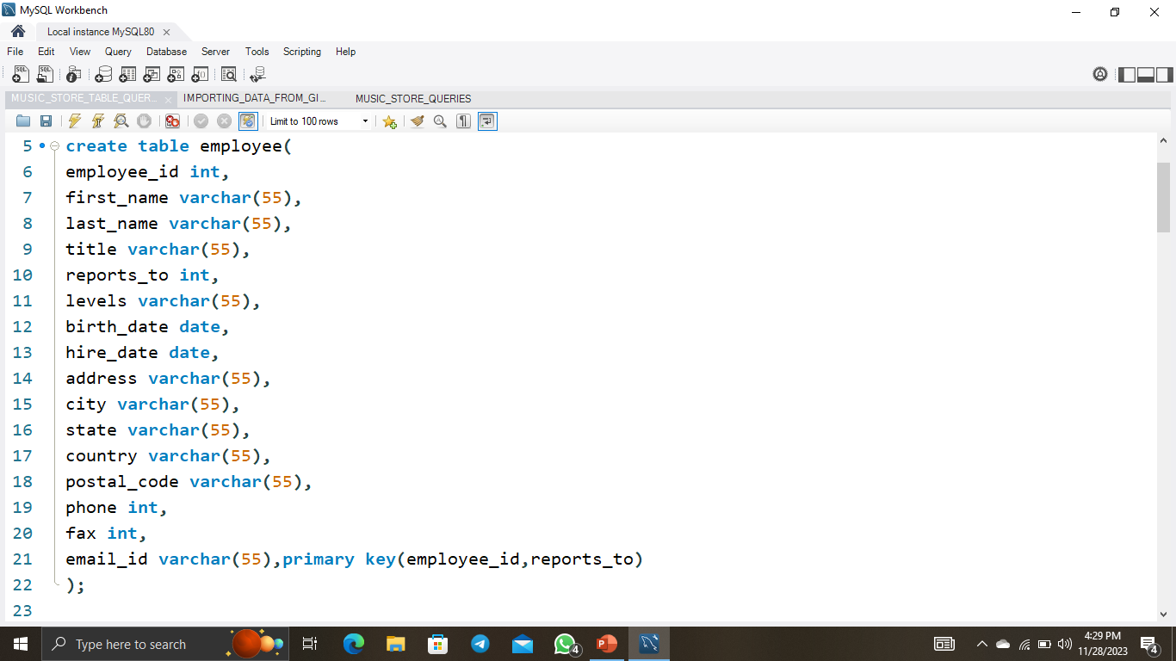
CREATING EMPLOYEE TABLE

Slide 7
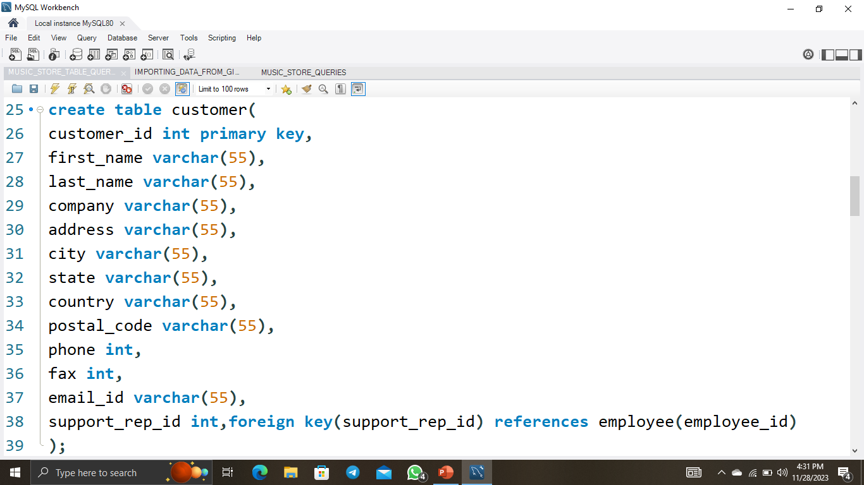
CREATING CUSTOMER TABLE

Slide 8
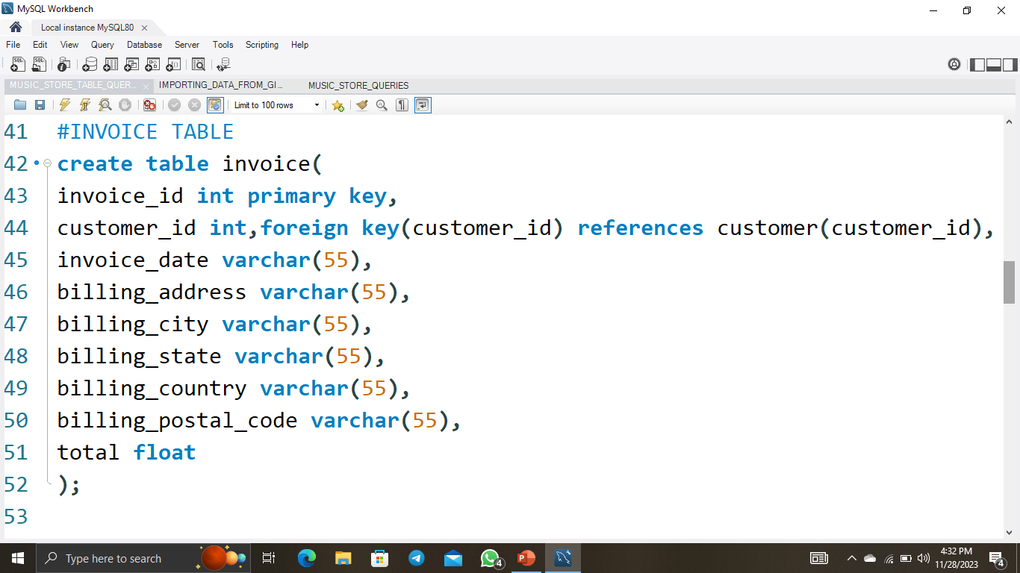
CREATING INVOICE TABLE

Slide 9
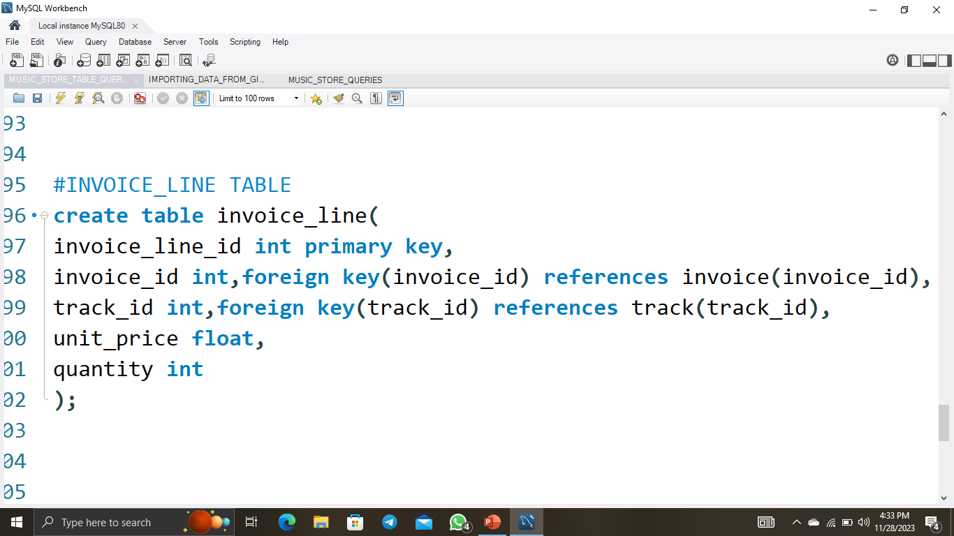
CREATING INVOICE_LINE TABLE

Slide 10
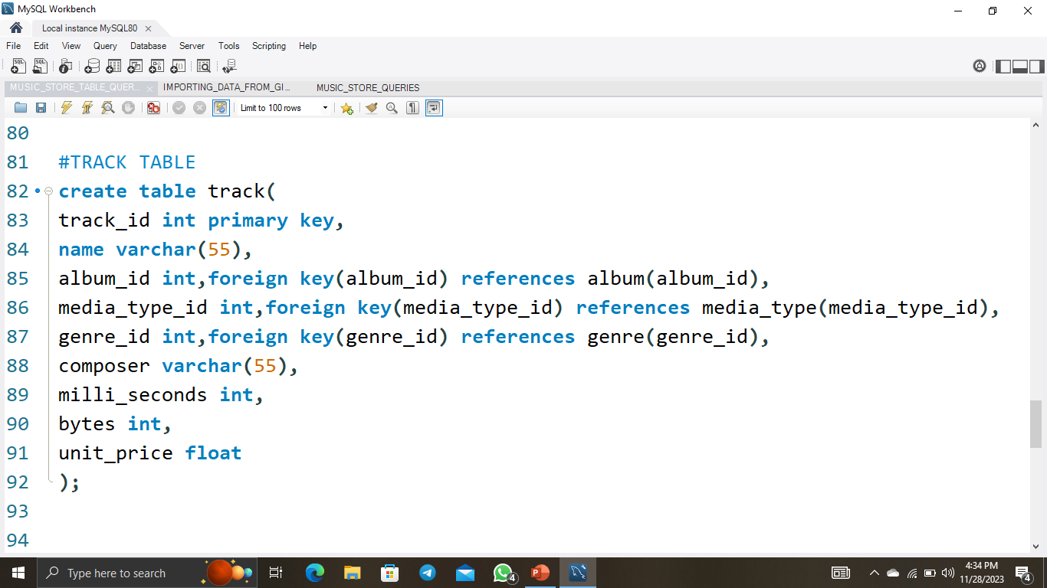
CREATING TRACK TABLE

Slide 11
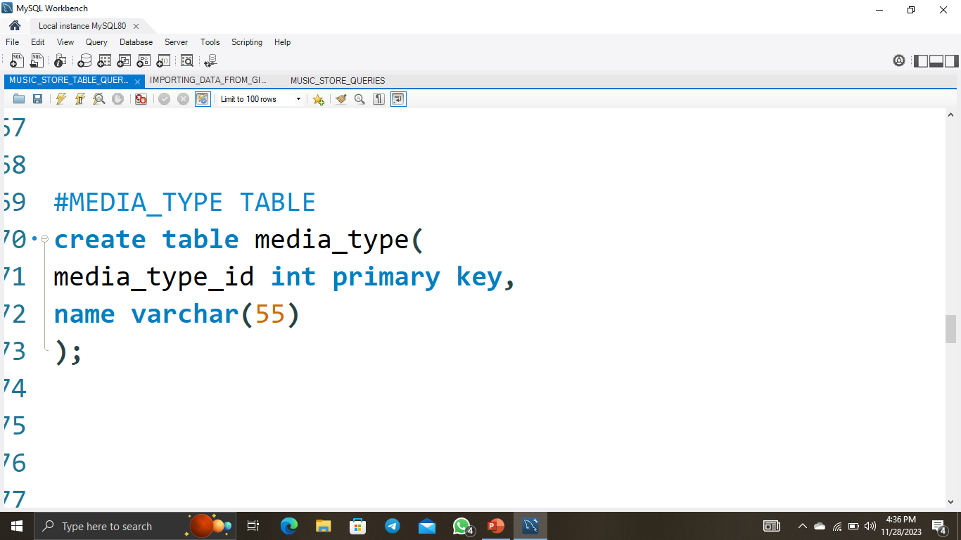
CREATING MEDIA_TYPE TABLE

Slide 12
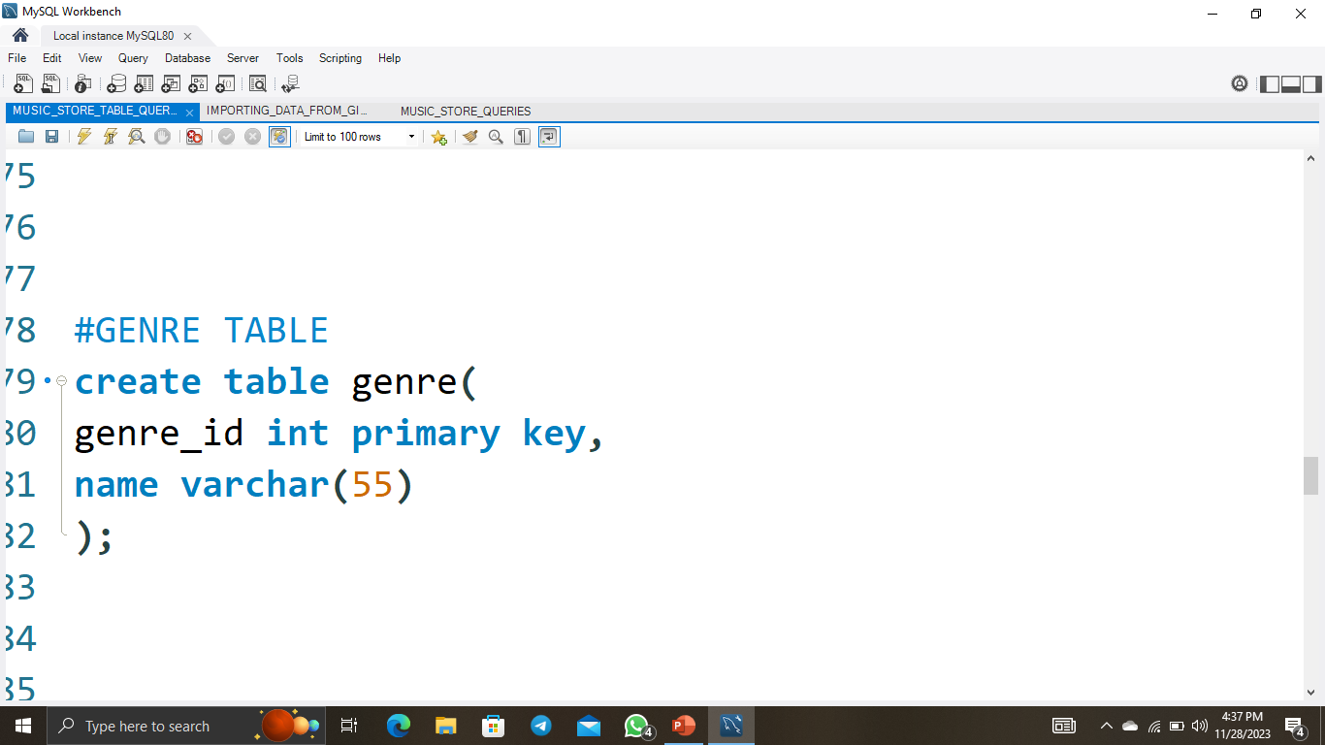
CREATING GENRE TABLE

Slide 13
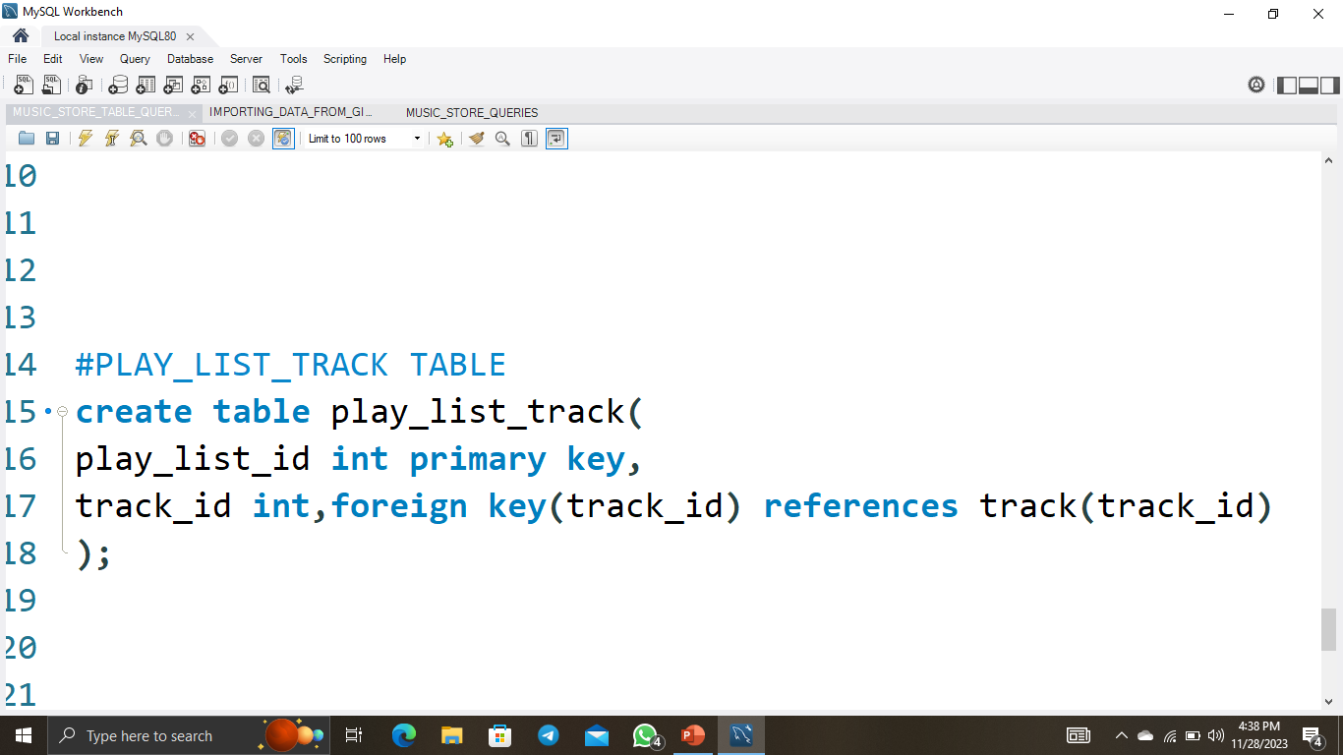
CREATING PLAYLIST_TRACK TABLE

Slide 14
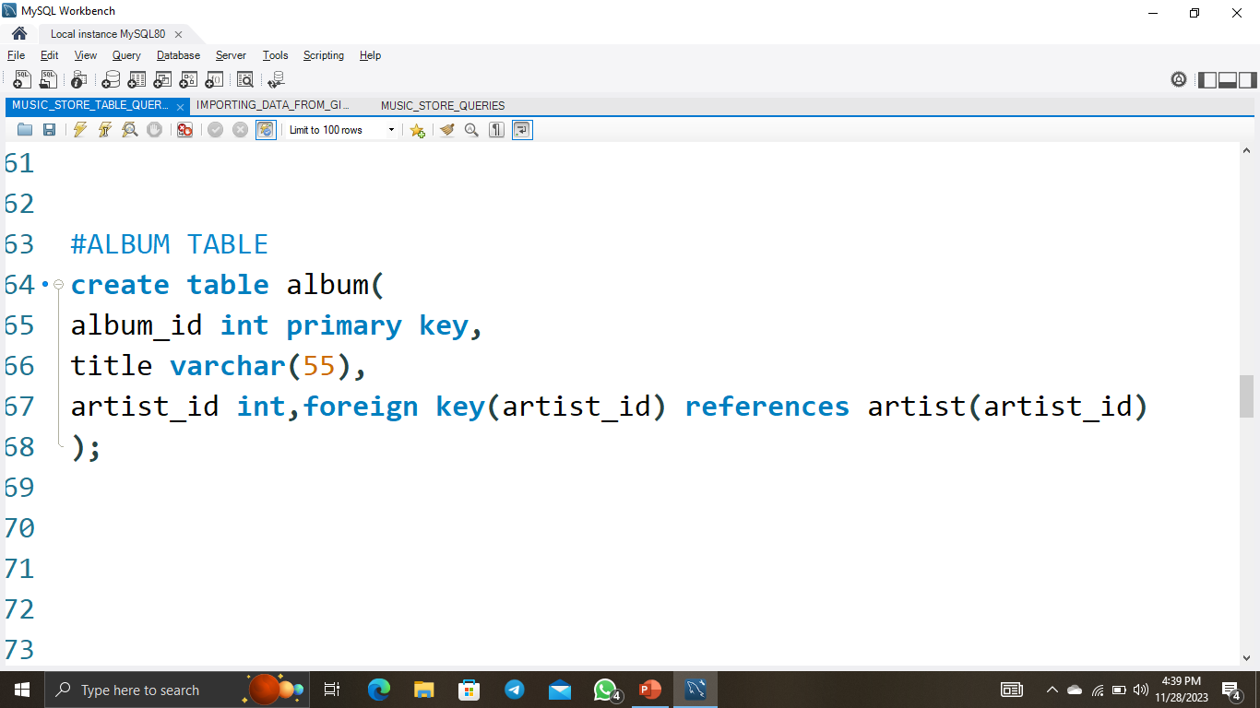
CREATING ALBUM TABLE

Slide 15
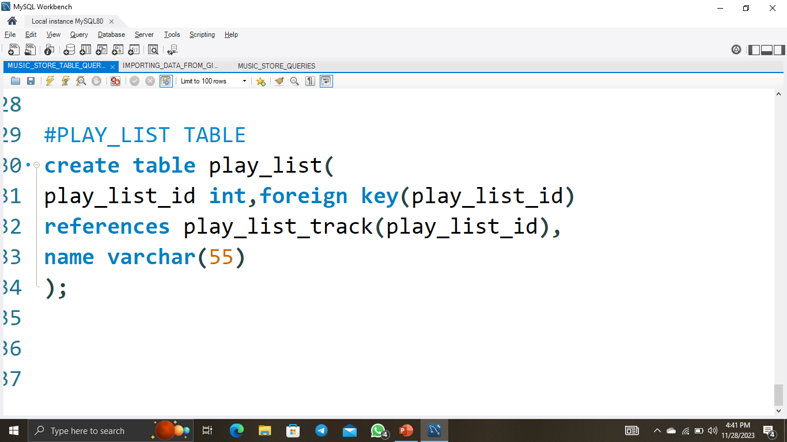
CREATING PLAYLIST TABLE

Slide 16
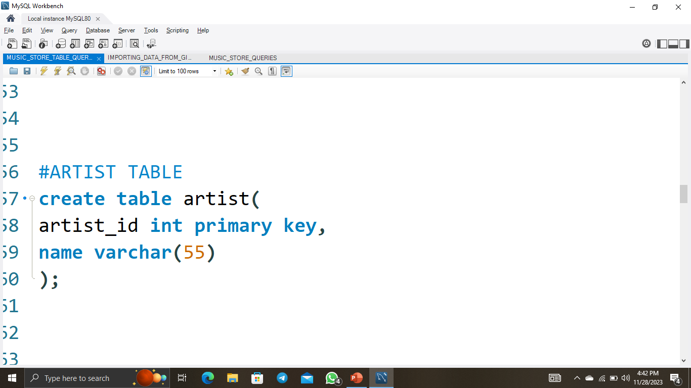
CREATING ARTIST TABLE

Slide 17
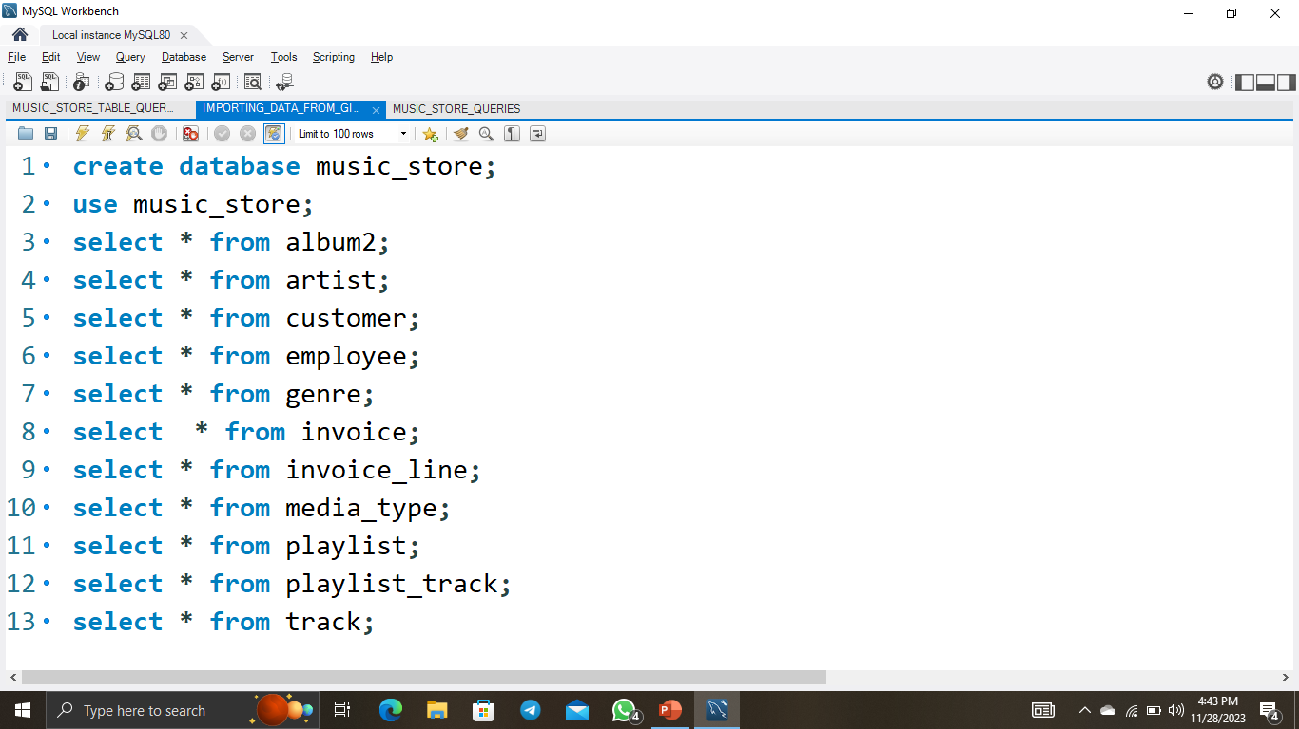
IMPORTING AND RETREIVING THE DATA

Slide 18
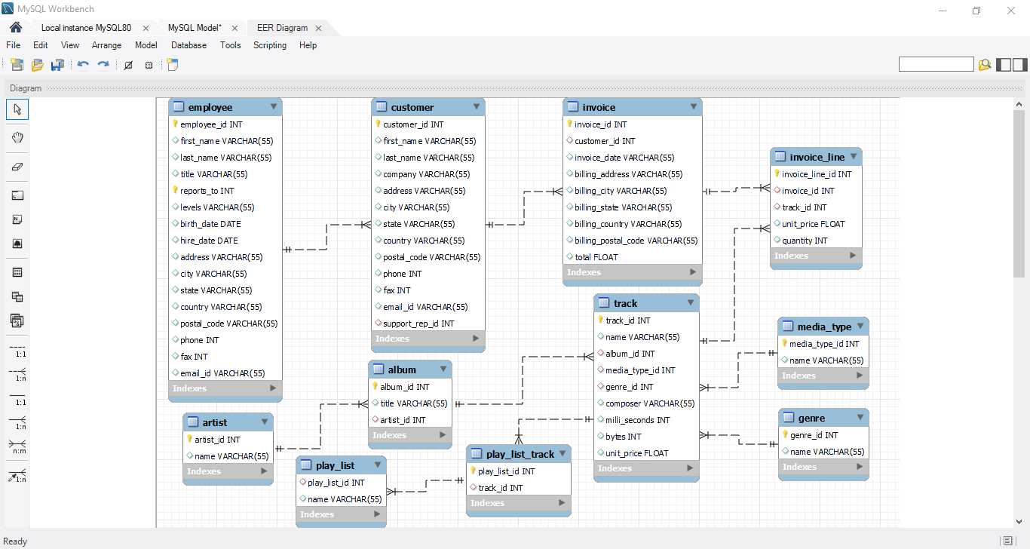
SCHEMA DIAGRAM

Slide 19

Q1: Who is the senior most employee based on job title?
select title , first name ,last name from employee order by title desc limit 1;

Slide 20
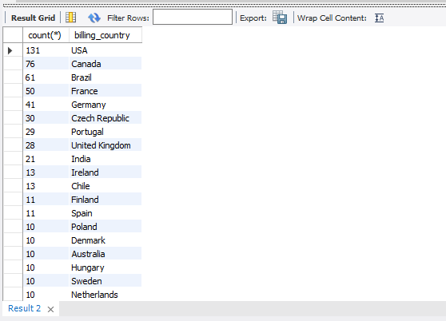
Q2: Which countries have the most Invoices?
select count(*),billing country from invoice group by billing country order by count(*) desc;

Slide 21
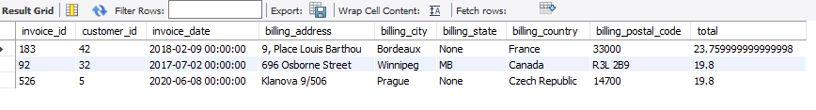
Q3: What are top 3 values of total invoice?
select * from invoice order by total desc limit 3;

Slide 22

Q4: Which city has the best customers? We would like to throw a promotional Music Festival in the city we made the most money. Write a query that returns one city that has the highest sum of invoice totals. Return both the city name & sum of all invoice totals
select billing city ,sum(total) from invoice group by billing city order by sum(total) desc limit 1;

Slide 23

Q5: Who is the best customer? The customer who has spent the most money will be declared the best customer. Write a query that returns the person who has spent the most money.
SELECT customer.customer_id , customer.first_name , customer.last_name, sum(invoice.total) from customer, invoice where customer.customer_id=invoice.customer_id group by customer.customer_id, customer.first_name, customer.last_name order by sum(invoice.total) desc limit 1;

Slide 24
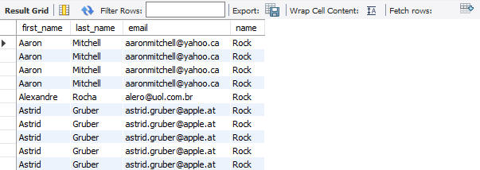
Q6: Write query to return the email, first name, last name, & Genre of all Rock Music listeners. Return your list ordered alphabetically by email starting with A.
select customer.first_name,customer.last_name,customer.email,genre.name from customer, invoice, invoice_line, track, genre where customer.customer_id=invoice.customer_id and invoice.invoice_id=invoice_line.invoice_id and invoice_line.track_id=track.track_id and track.genre_id=genre.genre_id andgenre.name="rock“ order by customer.email;

Slide 25
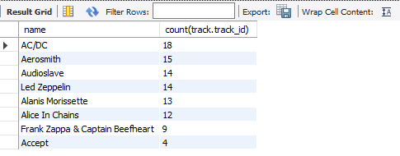
Q7: Let's invite the artists who have written the most rock music in our dataset. Write a query that returns the Artist name and total track count of the top 10 rock bands.
select artist.name, count(track.track_id) from artist join album2 on artist.artist_id=album2.artist_idjoin track on track.album_id=album2.album_idjoin genre on genre.genre_id=track.genre_id where genre.name like "rock“ group by 1order by count(track.track_id) desc limit 10;

Slide 26
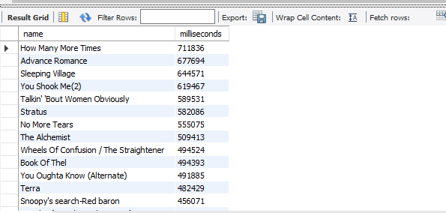
Q8: Return all the track names that have a song length longer than the average song length. Return the Name and Milliseconds for each track. Order by the song length with the longest songs listed first.
select name , milliseconds from track where milliseconds>(select avg(milliseconds)from track)order by milliseconds desc limit 1;

Slide 27
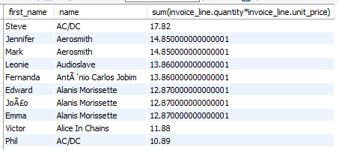
Q9: Find how much amount spent by each customer on artists? Write a query to return customer name, artist name and total spent
select customer.first_name, artist.name, sum(invoice_line.quantity*invoice_line.unit_price) from customer,invoice,invoice_line,track,album2,artistwhere customer.customer_id=invoice.customer_id and invoice.invoice_id=invoice_line.invoice_id and invoice_line.track_id=track.track_id and track.album_id=album2.album_id and album2.artist_id=artist.artist_id group by customer.first_name, artist.name order by sum(invoice_line.quantity*invoice_line.unit_price) desc;

Slide 28
REFERENCES
► GITHUB
DATABASE AND TOOLS
► MYSQL WORKBENCH

Slide 29
Questions Answered
What are the most popular genres of music?
What are the most popular artists?
What are the most popular songs?
What are the average prices of different types of music?
What are the most popular countries for music purchases?

Slide 30
Results
The results of the project are as follows:
The most popular genre of music is "Rock".
The most popular artist is "Queens".
The most popular song is "War Pigs".
The average price of an album is $1.
The most popular country for music purchases is the United States.

Slide 31
Conclusion
The project was successful in answering the set of questions about the store's business performance. The results of the project can be used by the store to make decisions about its marketing and product offerings.

Slide 32
THANK YOU

